Slide 1
Milestone
Project Planning Phase
Prepare milestone
Date | 18 October 2022
Team ID | PNT2022TMID50619
Project Name | Project -Personal Expense Tracker Application
Maximum Marks | 8 Marks

Slide 2
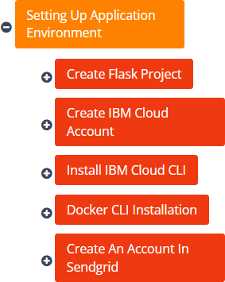
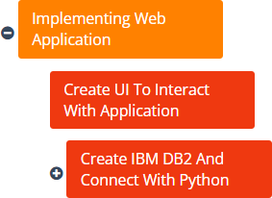
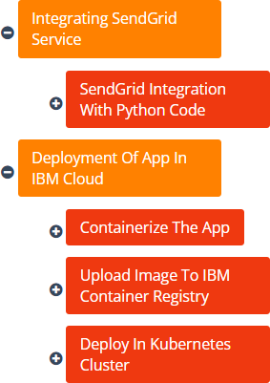
22 – 27th August
Preparation Phase

Slide 3


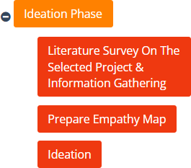




September
29th August – 17th
Ideation Phase
Ideation Phase
Ideation
Empathy Map
Literature Survey
4.4
4.6
4.8
5
5.2
5.4
5.6
5.8
6
6.2
Days

Slide 4


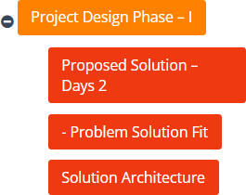



October
19th September – 1st
Project Design Phase 1
Project Design Phase 1
Solution Architecture
Problem Solution
Proposed Soln
0
1
2
3
4
5
6
Days

Slide 5

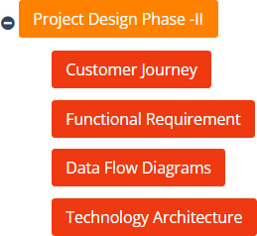

3 – 15th October
Project Design Phase 2
Project Design Phase 2
Technlogy Architecture
Data Flow Diagram
Functional Requirements
Customer Journey Map
2
3
4
5
6
Days

Slide 6


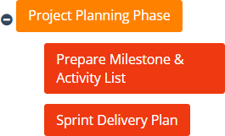


17 – 22nd October
Project Planning Phase
Project Planning Phase
Sprint Delivery Plan
Milestones & activity list
2
3
4
5
6
Days

Slide 7
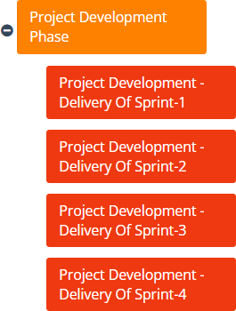
Project Development
Phase
24th October – 19th
November
Project Development Phase
sprint 4
sprint 3
sprint 2
sprint 1
0
1
2
3
4
5
6
Days

